Slide 1
Data Analytics Final Report: Buffalo Bills & Cold Weather Advantage
Elizabeth Rice
Notes:
“Hello, my name is Elizabeth Rice, and this project examines whether the Buffalo Bills gain a measurable performance advantage when playing home games in cold weather. This work analyzes 20+ years of game outcomes and weather conditions to evaluate whether the Bills’ new open-air stadium makes sense from a performance perspective.”

Slide 2
Problem Area: Why it Matters & What I Want to Predict
Do the Buffalo Bills perform better at home in cold weather?
Why it matters: stadium design, team strategy, analytics insight
Prediction Goal: win probability & scoring margin under cold conditions
Notes:
“The problem I wanted to explore is whether the Bills actually perform better at home when temperatures drop below freezing. This question became especially relevant after the team chose to build a new open-air stadium rather than a dome.
My prediction goal was to see whether cold home conditions increase win probability or scoring margin, indicating a real advantage.”

Slide 3
The Data: Sources, Relevance & Relationship
TeamRankings — game results, scoring margins, trends
NFLWeather — temperature, wind, precipitation
Years analyzed: 2000–2020
Derived variables: cold32, cold40, wind chill, precip flags
Merged by date + opponent
Notes:
“I used two complementary datasets: TeamRankings for performance metrics, and NFLWeather for game-day weather. These were merged by date to produce a unified table containing temperature, wind, precipitation, scoring margin, and win/loss. I also created derived variables like cold32, cold40, wind chill, and precipitation flags to standardize conditions.”

Slide 4
How Analysis was Conducted
Home cold games win ~70%
Away cold games win ~40%
Scoring margin stable at home in cold; declines away
Note a few biases: opponent strength, Josh Allen era, sample size
Notes:
Preliminary plots showed promising signals. The Bills won about 70% of freezing home games but only 40% of freezing away games. Their scoring margin also remained stable at home in cold, but declined significantly in away games under the same conditions. These trends motivated deeper modeling to confirm the effect while controlling for confounders

Slide 5
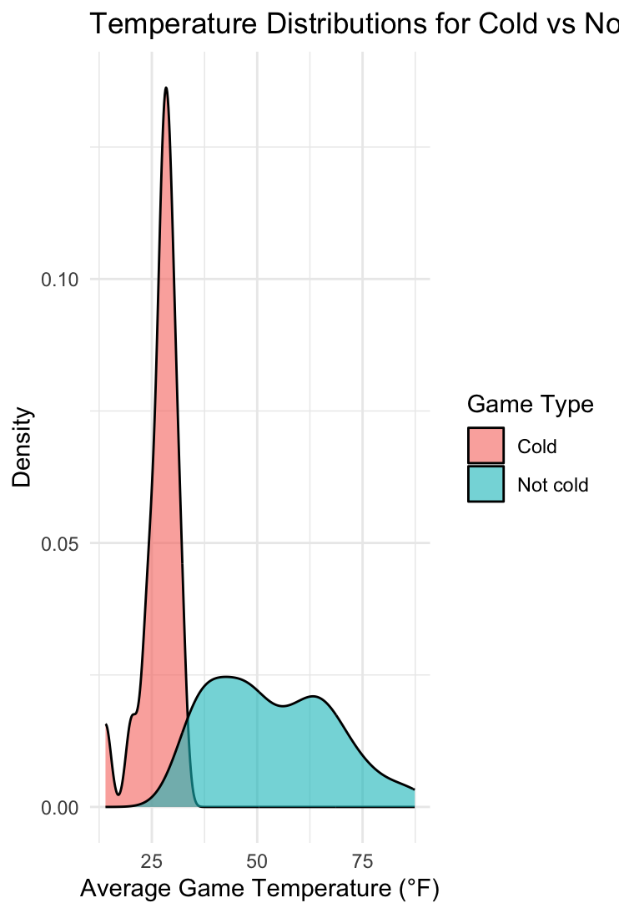
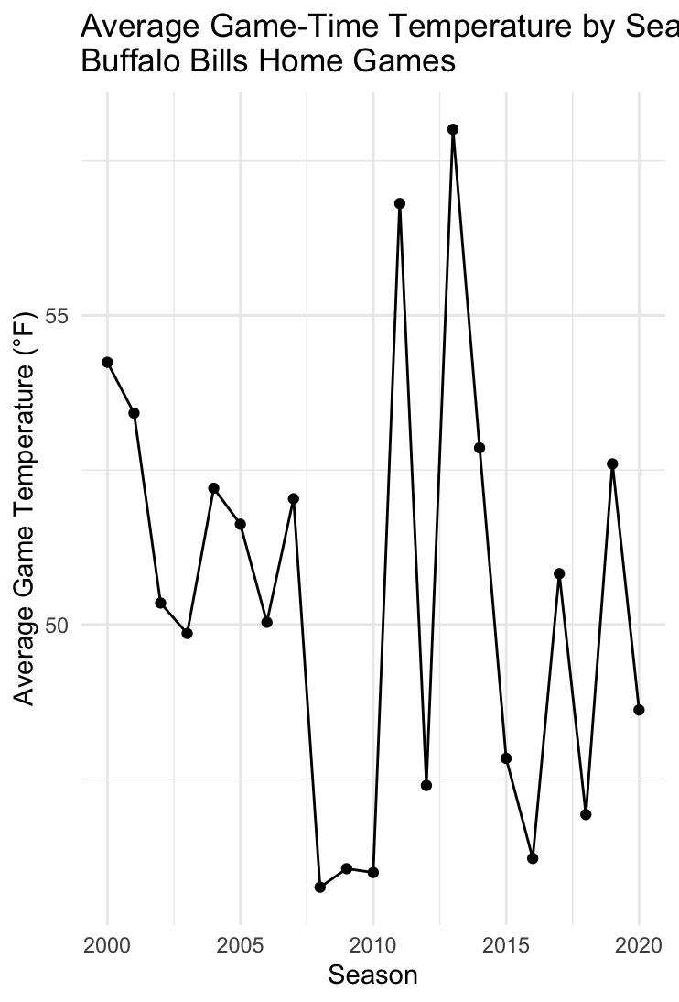
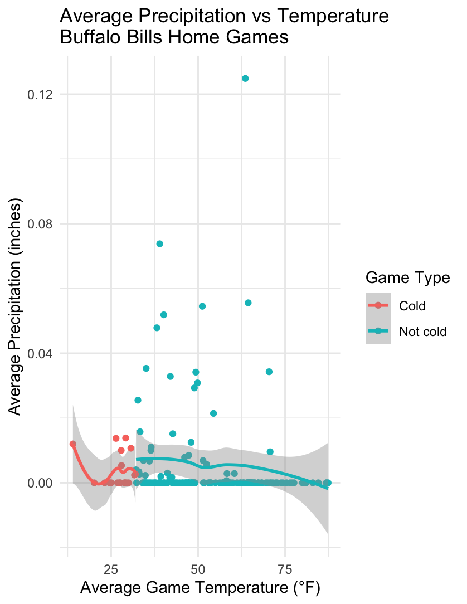
Exploratory Visualizations
Notes:
“These plots show how the Bills’ home-game temperatures are distributed, how cold and non-cold games form two distinct groups, and how weather conditions like precipitation vary with temperature. Together, they highlight that cold games represent a clearly different environment, setting the stage for deeper model analysis.”

Slide 6
Model Construction
Models Used:
Logistic Regression
Linear Regression
Random Forest
Gradient Boosted Trees (XGBoost)
Notes:
“I built four models to evaluate the cold-weather effect. Logistic and linear regression helped quantify the impact of temperature and interactions. Random Forest and XGBoost allowed me to explore nonlinear patterns and variable importance.”

Slide 7
What Worked? What Didn’t Work?
Didn’t Work:
Temperature alone was weak predictor
Precipitation was noisy
Wind > 25 mph created variability
Worked:
home×cold32 and home×cold40 consistently significant
tree models revealed strong interactions
cross-validation produced stable ROC-AUC values
Notes:
“Across all methods, the interaction between being at home and playing in cold temperatures consistently produced positive, significant effects. Temperature by itself wasn’t very predictive, but temperature combined with home status was. Precipitation had weaker signal, and extreme wind introduced noise.”

Slide 8
Optimization & Validation
10-fold cross-validation
Metrics: ROC-AUC, Brier Score, F1, RMSE
Sensitivity tests:
  redefine cold as ≤ 40°F
  exclude high-wind games
  test 2018–2024 Josh Allen era separately
Notes:
“I validated each model with 10-fold cross-validation and evaluated logistic models using ROC-AUC and Brier scores. Regression models used RMSE. I also ran robustness checks by redefining cold thresholds, removing extreme-wind games, and isolating only the Josh Allen era. All tests showed consistent direction.”

Slide 9
Predictions & Decisions
Cold home games increase win probability by ~5–7%
Increase scoring margin by ~3 points
Supports open-air stadium design
Strategic implication: Bills should embrace late-season cold
Notes:
“The models predict that freezing home games increase win probability by five to seven percentage points and boost scoring margin by about three points. These effects are modest but real — enough to matter over multiple seasons. This supports the Bills’ decision to keep an open-air stadium: the cold is part of their competitive advantage.”

Slide 10
Conclusion
Yes: Bills gain a mild but real cold-weather home advantage
Consistent across all models
Future work: league-wide comparison and play-by-play analysis
Notes:
“In conclusion, the data strongly suggest that the Buffalo Bills benefit from cold weather when playing at home. This effect appears across all models and remains stable across seasons and quarterback eras. It validates the idea that the team is built for cold weather and offers an analytical defense of the new stadium’s open-air design.”

Slide 11
THANKS!
Any Questions?

